Slide 1
Revenue – 2023 Q1 Budget Approved / Actual - Key Breakdown

Slide 2
Highlight on revenue budget 2022 as set by DoF
The Y2022 revenue target has been increased by DoF from AED 38.4 m (submitted by KU) to AED 66.2 m (approved by DoF).
The increase in revenue target by DoF was due to an expectation from DoF that KU shall collect in Y2022 part of the outstanding from Ankabut (as cash revenue). This was not the case as no payment was made by Ankabut to KU and this is planned to be shareholder equity in Ankabut.
KU has achieved well in actual revenue (cash basis) against the originally submitted budget (above by 33%), but still beyond the revenue target set by DoF (less by 22%).

Slide 3
Performance against major revenue streams in Revenue budget for DoF
Income from sponsorship:
This is a key revenue coming from external sponsors of students, there were 141 sponsored students and which generated around AED 16.8 m during the year as compared t AED 24 m as set by DoF and AED 14.6 as submitted (expected) by KU. The budget revenue for Y2023 is AED 15.9 m against which we achieved 45% by the end of 1st quarter and expect to achieve the target before the end of the year.
Tuition Fee:
This revenue represents the tuition fees collected directly from the students either self-financed or those under a partial scholarship from KU.
There were 934 scholarships in the year, actual cash revenue was AED 10.8 m against AED 12 m (budget), and AED 5.7 m as actual cash in 1st quarter against AED 9.6 m (full 2023 revenue under this stream). KU has achieved 60% of the target revenue for the year during the 1st quarter.

Slide 4
Performance against revenue streams in Revenue budget for DoF
Continue education (training):
This item is related to training services under the agreement with “SEHA” and other training provided by the Continuous Education Center to external clients. KU has done well in the item in Y2022 resulting in revenue of AED 6.4 m as compared to AED 6 m target revenue.
The reason for underspending during this quarter is that the agreement with “SEHA” is under update for rates hence the revenue was not yet reflected.
Transportation:
Revenue collected from students for using our transportation (between Abu Dhabi and other emirates), does not reflect a full recovery of cost but part of it. Actual revenue was above the target in 2022 by 15%.
Overhead recovery & charge-back within ledgers:
This revenue reflects some overhead charges and some chargeback between the main ledger (KUST) and other ledgers (e.g. KUX ledger).

Slide 5
Building rent
Building rent: residents
This item includes rent collected for accommodation for non-eligible students such as graduate students etc.
The collection of residence rent was 98% of the target Y2022 and 40% up to the 1st quarter as compared to budget 2023.
Building rent: Commercial properties (including shops):
This item includes rent collected from outlets/ restaurants and other venue rentals.
The revenue was below the target as the university follows different kinds of agreements with outlets including revenue sharing, minimum sales, etc. This revenue target (budget) was revised to a lower level in 2023 to reflect reality.
More details in the next sheet

Slide 6
Building rent: Commercial properties (including shops) |  |  |  |  |  |  | Revenue up Y2022
SN | Campus | Location | Brand | Status | Type | Rent
1 | Main | Building R | Bloom Room Flower & Café | Open | F&B Retail | 10% | 2,735.14
2 | Main | Building R | Costa | Open | F&B Retail | 10% Disc + 10% Rev | 25,485.80
3 | SAN | Building 2 & Arzanah | Costa | Open | F&B Retail | 10% Disc + 10% Rev
4 | Main | Building E | Blue Mart (ADNH) | Open | Shopping Retail | 7% | 171,566.12
5 | Main | Building E Foodcourt | So Daily ADNH | Open | F&B Retail | Refer to contract
6 | Main | Central Spine | Haagen Dazs (ADNH) | Open | F&B Retail | 5%
7 | Main | Building A | Lavazza (ADNH) | Open | F&B Retail | 10%
8 | SAN | Building 5 & Building 6 | So Daily ADNH | Open | F&B Retail | Refer to contract
9 | Main | Building E Foodcourt | House of Tea | Open | F&B Retail | 10% Revn share | 74,040.72
10 | SAN | Building 6 | House of Tea | Open | F&B Retail | 10%
11 | Main | Central Spine | Green for Life | Open | F&B Retail | 12% | 58,946.51
12 | SAN | Building 1 | Green for Life | Open | F&B Retail | 12%
13 | Main | Building B | SHOT CAFÉ | Open | F&B Retail | Sales Below AED 1 M - 10% Sales Above AED 1 M - 12% Sales Above AED 2 M - 15 | 33,108.43
14 | SAN | Building 3 | Shot Café | Open | F&B Retail | 15%
15 | Main | Building E | Starbucks | Open | F&B Retail | AED 134,550 or 8% Revn Whichever higher | 157,294.17
16 | Main | Building E | MAGRUDY ENTERPRISES | Open | Shopping Retail | 10% Disc + 7% Revn share | 34,771.32
17 | Main & ADNOC School | Building E Foodcourt | Gourmet International (Basil) | Open | F&B Retail | 12% Revn Share | 110,715.60
18 | Main | Building E Foodcourt | Doctor Shawarma - Taboon from Nov 22 | Open | F&B Retail | 10% Revn share | 17,255.04
19 | Main | Building B | Bike Shop | Open | Shopping Retail | KU Outlet | 0.00
20 | Main | Building D | CHUBBY CHEEKS NURSERY | Open | Service | 1st Year 500AED / Child 2nd Year 120K 3rd Year 150K | 14,525.00
21 | Main | Female Gym | Oriental Spa | Open | Service | 20% Disc + 8% Revn Share | 29,765.67
22 | Main & SAN | NA | Q2 General Cleaning services LLC (Geo Wash) | Open | Service | Sales Less 100K = Rent 25K Sales Above 100K = Rent 20% | 12,362.87
23 | Main & SAN | - | Massafi Vending | Open | Service | 15% | 7,054.47
24 | Main & SAN | - | Yalla Food Vending | Open | Service | 5% | 1,966.90
25 | ADCON school | Girls hostel | Best Cup Café - Sole Proprietorship L.L.C | open | F&B Retail | 5% First Year 2022 - 10% 2nd and 3rd year | 7,917.06
26 |  | - | CONVENIENCE ARABIA LLC Total | close | F&B Retail | Fixed Annual Rental at beginning of the year 1.5% of annual merchandise sales | 11,533.56
27 | ADCON school | Girls hostel | Kitchen Sharer | open | F&B Retail | 10% Revenue share | 1,752.54
28 | SAN | Arzanah | O2 CAFETERIA-CAF CAFÉ | open | F&B Retail | 10% revenue share | 1,599.65
29 |  | - | Waterless Cleaning Services LLC | close | Service | 26% revenue share | 9,117.98
30 | Main & ADNOC | - | CLASS CAFÉ | open | F&B Retail | 10% revenue share-Main campus and 5% revenue share-ADNOC School | -
31 | Main | Building L | Low Calories | open Jan 2023 | F&B Retail | yearly 60,000/- fixed | 0.00
32 | Main | Building M | Sky Line | open Jan 2023 | Shopping Retail | 22% | 0.00
1 | Sports |  | Play Grounds Customers |  |  |  | 10,823.78
2 |  |  | Skill Plus Sport Service |  |  |  | 143,476.18
3 |  |  | Al Gharbia Sports |  |  |  | 13,514.27
 |  |  | Cash Basis adjustments |  |  |  | (27,490.78)
Total of rental |  |  |  |  |  |  | 923,838.00

Slide 7
Other revenue
Item | Approved Budget | Actuals -Cash Basis
Certificate issuance fee | 26,400 | 31,251
Identity card issuance fee | 11,000 | 3,158
Replacement fee for lost document | 6,600 | 45,050
Sale of textbooks & educational publication | 390 | 390
Other services: | 0 | 25,714
Property damage | 3,000 | 74,010
Sundry receipts | 0 | 3,369,160
Other Students Services | 2,106,071 | 644
Total | 2,153,461 | 3,549,376
Notes:
“Other student services” including some small revenue such as book lending.
“Sundry Receipts”’ revenue covers other student-related activities.

Slide 8
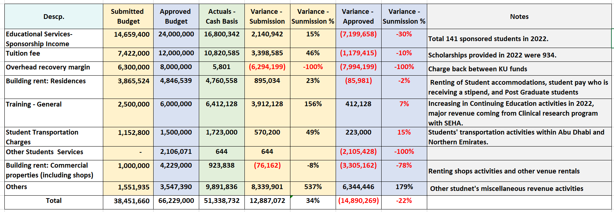
Revenue Performance against submitted budget and approved budget 2022

